Slide 1
Project Status Snapshot
-- ECO IT eBusiness Financial Gateway
Shan, Ying
2005-10-17

Slide 2
Agenda
Project Overview
Project Description
System Architecture
Project Org-Chart
Project Schedule
Current Status
Issues, Challenges and Actions
Good Practices, Lessons Learned, Highlights
Others

Slide 3
Project Overview
Name： ECO IT eBusiness Financial Gateway
Duration： 07/01/2005~05/31/2006
Project Size： 5 persons 4 months
Project Type： T&M, On-going
Customer： ECO-IT ,Houston USA
Rick Gibson, Brian Hodgdon
Technologies： J2EE, .NET

Slide 4
Project Description
What is eBusiness Financial Gateway?
  credit card processing
  real-time authorization
  integrate with payment and risk management.

Slide 5
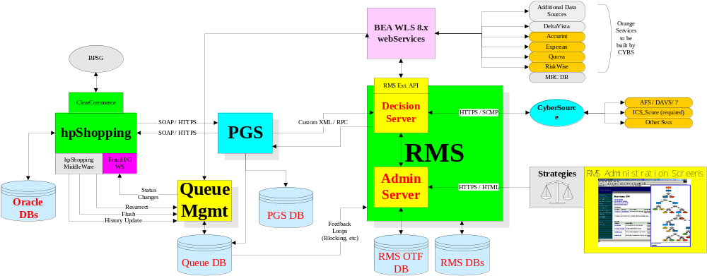
System Architecture

Slide 6
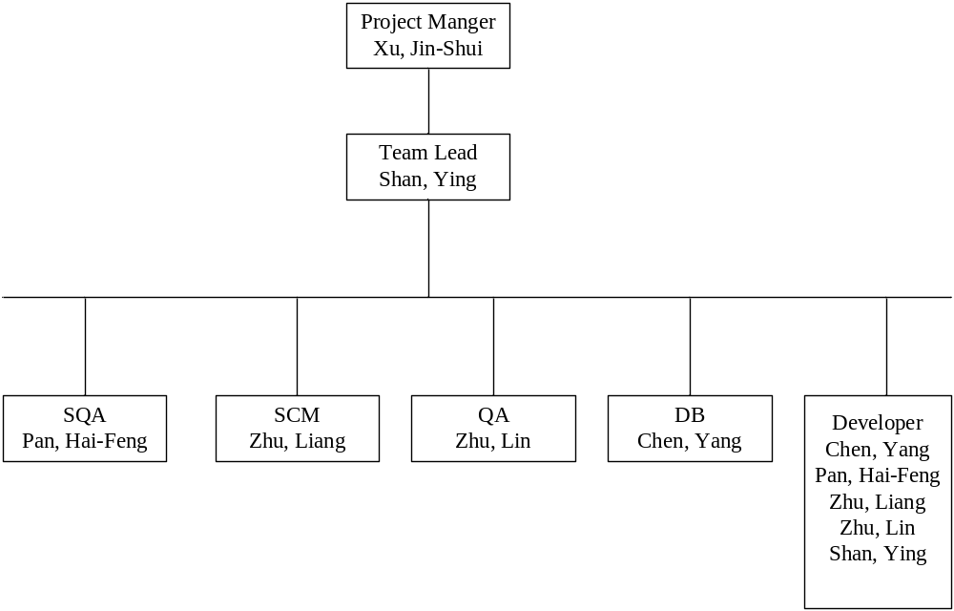
Project Org-Chart

Slide 7
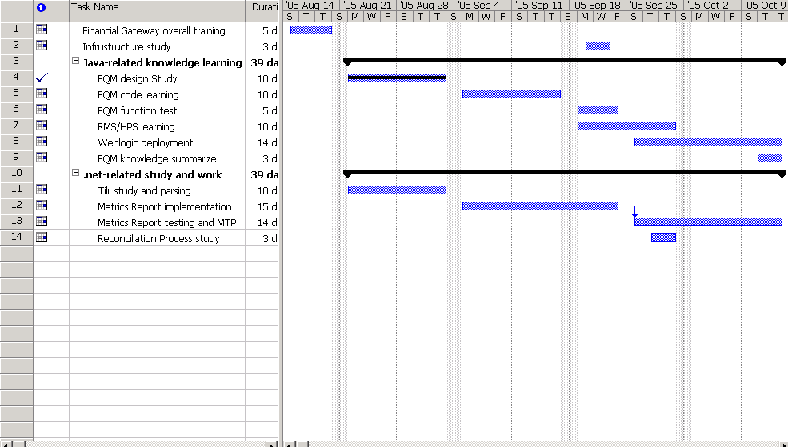
Project Schedule

Slide 8
Current Status
★Overal Status：
１．Knowledge transfer completed.
2. Metrics Report completed
3．China development environment setting-up has already started

Slide 9
Issues, Challenges and Actions
1．Lack of Server Machine。
Action：need 2 server, (DB/.net server, Weblogic server)
２．Task not be signed.
Actions：1. Continue study system
2. Set up environment and do test

Slide 10
Good Practices, Lessons Learned, Highlights
. Daily meeting – Transfer each day’s knowledge to China team in real time
. Good relationship with customer result in quick knowledge transfer

Slide 11


